Slide 1
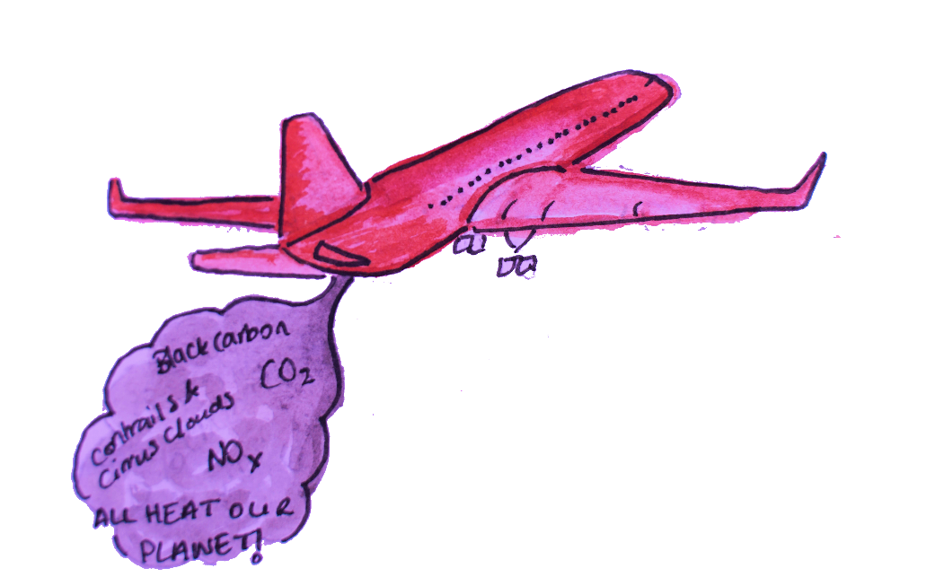
Notes:
EU Facilitation
EU – Stop Favouring Aviation! Through lenient policies and state aid, the EU favours the aviation industry over its public transportation counterparts. Benefits through tax exemptions and free carbon emission allowances need to be halted.

Slide 2
Dialogue night

Slide 3
Welcome!
What are we going to do today?
What is ExPlane?
Long term vision
Who is ExPlane?
Urgency
What can you do?
Discussion

Slide 4
What is ExPlane?
A NETWORK OF STUDENTS AND STAFF STANDING UP AGAINST THE IMPACTS OF FLYING…
…Asking OUR UNIVERSITIES TO LEAD BY EXAMPLE IN TRAVELLING CONSCIOUSLY.

Slide 5
What is ExPlane?
The idea was developed during the project Sail to the COP. A group of 60 European change makers who called for fair and sustainable travel sailing to and attending the UN Climate Conference in 2019.

Slide 6
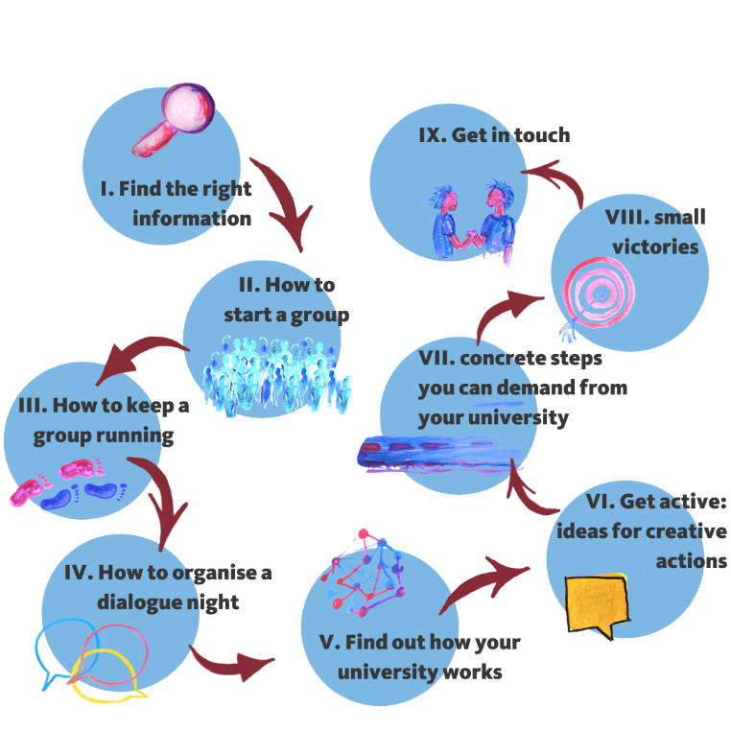
What is ExPlane?
Website
Toolkit
Network
Notes:
With a website, campaign toolkit and a network we try to make a change through both individual and institutional changes.

Slide 7
Our Long-term Vision
Collaborations within a diverse academic community
Having a efficient digital platform & efficient digital communication
Accessibility and diversity
Travel policies that are both climate friendly & socially inclusive

Slide 8
Who is ExPlane?
The ExPlane team
& volunteers
Our Partners
Our Network of
students & staff

Slide 9
Urgency
Emissions travel industry
Total global emissions to stay below 1.5° warming
Peeters, P. (2017). Tourism’s impact on climate change and its mitigation challenges.
De Correspondent, data: CVO, 2016

Slide 10
Urgency
Reasons why academics travel by planes.
Nursey-Bray, M., Palmer, R., Meyer-Mclean, B., Wanner, T., & Birzer, C. (2019). The fear of not flying: achieving sustainable academic plane travel in higher education based on insights from south Australia. Sustainability, 11(9), 2694.

Slide 11
What can you do?

Slide 12
Discussion
How did you experience travel behaviour on your university?
Does your university describe itself as green?
Can you guess how much your university flies?
Do you know people who choose to go by a more sustainable travel option to their exchange destination?
How can you change something at your university?
Are there opportunities for students to influence the university's behaviour?
How would you get the university’s attention on this topic?
Do you know people (students and/or staff) who would be interested in this topic as well?

Slide 13
Contact
www.timetoexplane.com
www.facebook.com/timetoexplane
@timetoexplane
symke@timetoexplane.com

